Slide 1
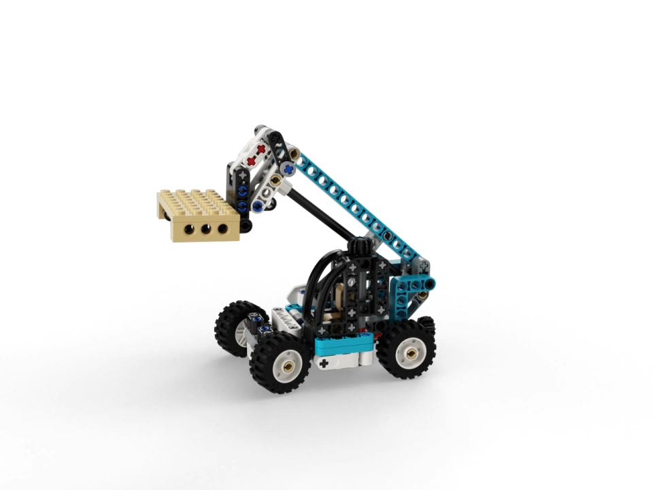
MECHANICAL DESIGN METHOD
Nima Abaeian
Sayna Arghideh

Slide 2
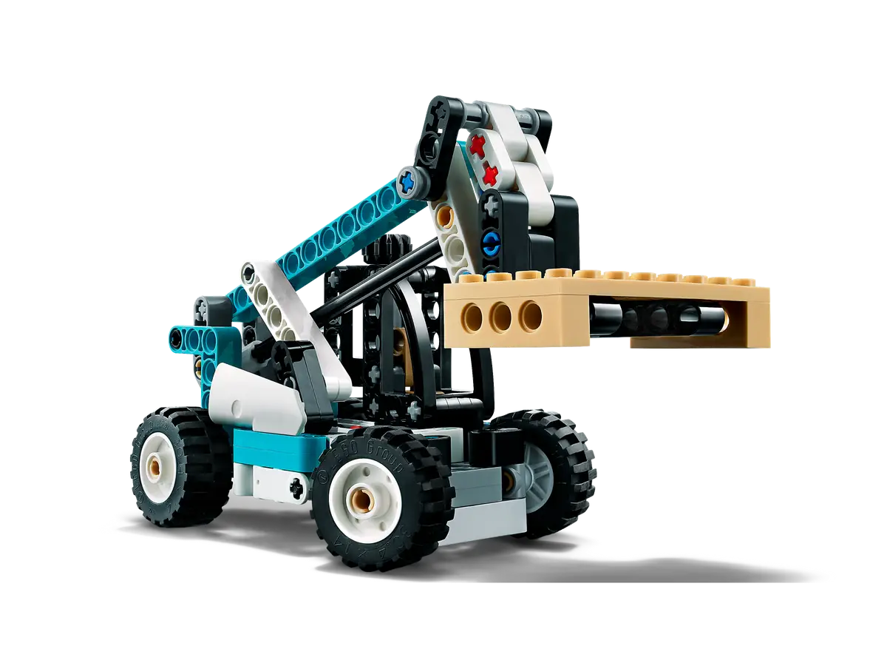
OVERVIEW
STEPS
Assembling a LEGO set using Creo 9
Designing the Parts
Part Alignment and Assembly
Connectivity and Interference Checking
Motion Simulation

Slide 3
Designing
parts
Measurement
Select the Plane
Sketch, Draw the Shape
Extrude
Fillets, chamfers, and appearance adjustments

Slide 4
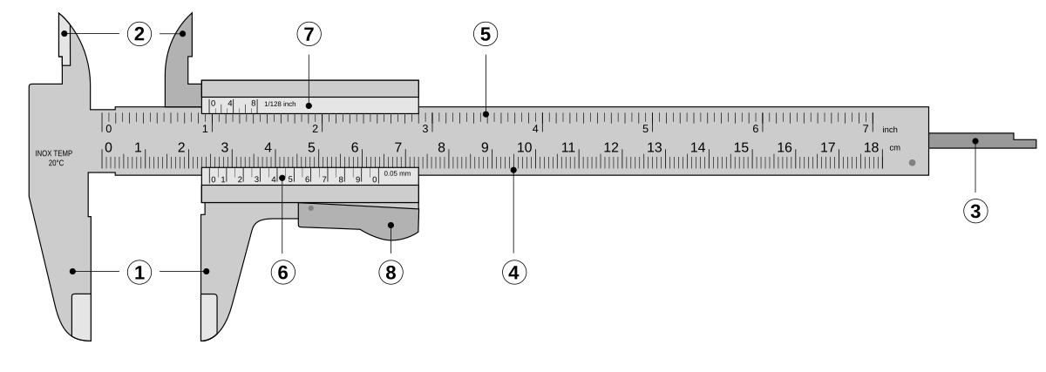
Measurement
Main Scale : Millimeters

Slide 5
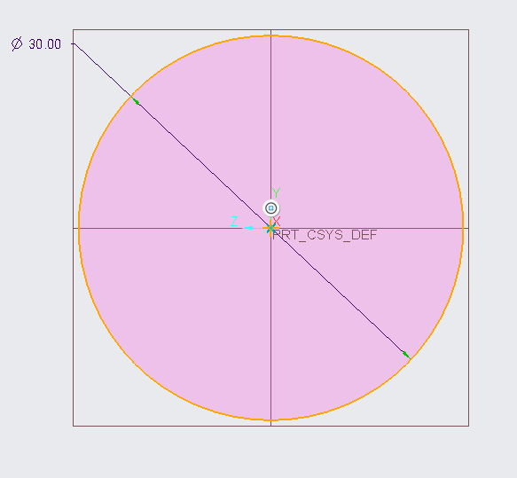
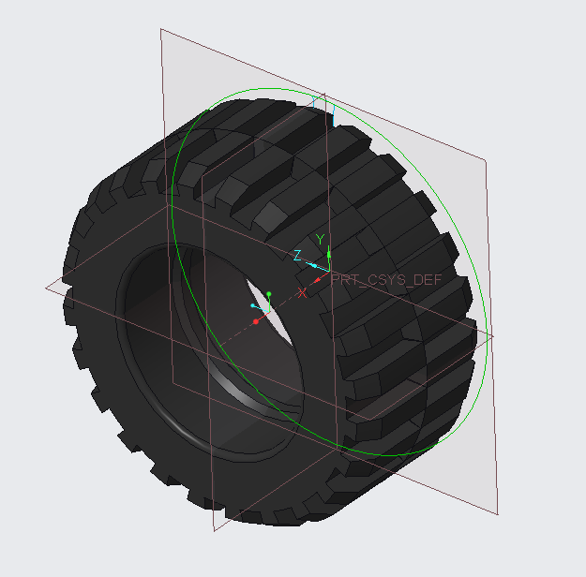
PART 4619323
Sketch : circle, line
Extrude
Pattern
Chamfer
Round

Slide 6
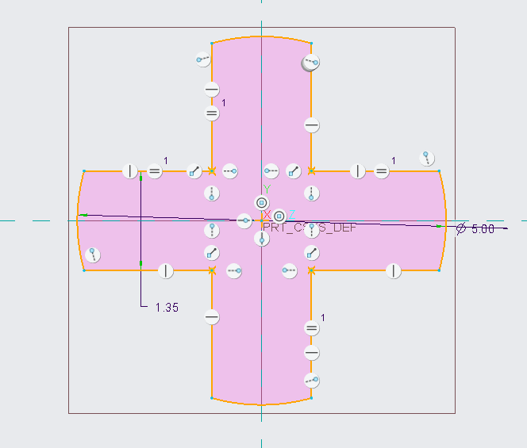
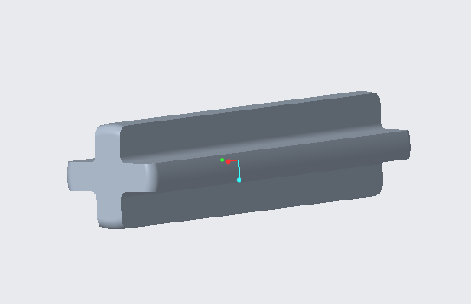
PART 4211815
Sketch : Line, Arc
Extrude
Round

Slide 7
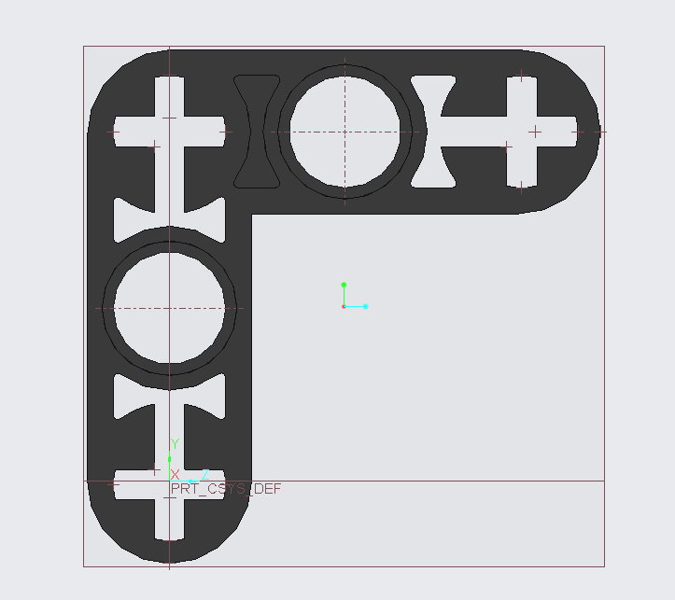
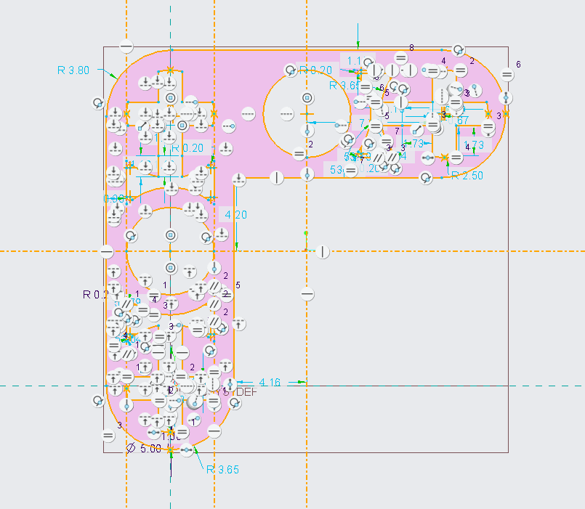
PART 6271810
Sketch : Line , Arc ,Circle
Constraint : Symmetric , Midpoint, Tangent entities, Horizontal , Point on entity
Extrude
Sketch and Extrude : Remove Material

Slide 8
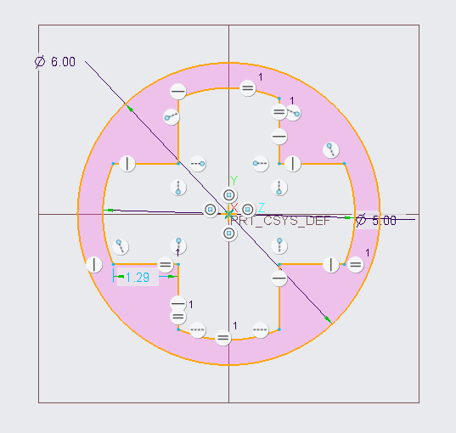
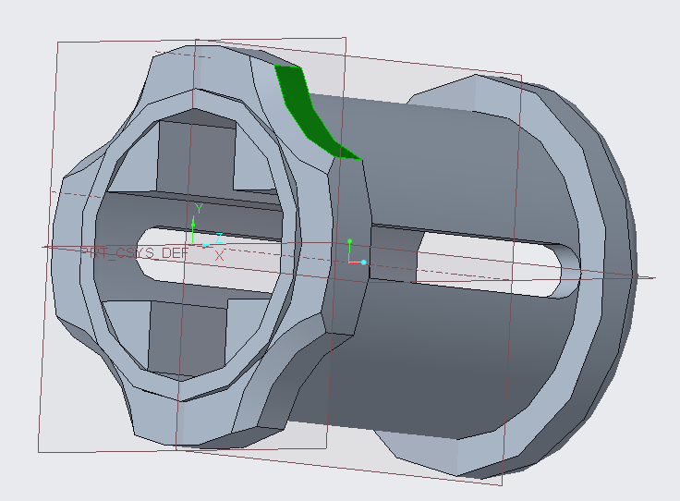
PART 6275844
Sketch : line, Arc, Circle
Constraint : Equal Length , Vertical , Point on Extension Line, Horizontal
Extrude
Chamfer
Round

Slide 9
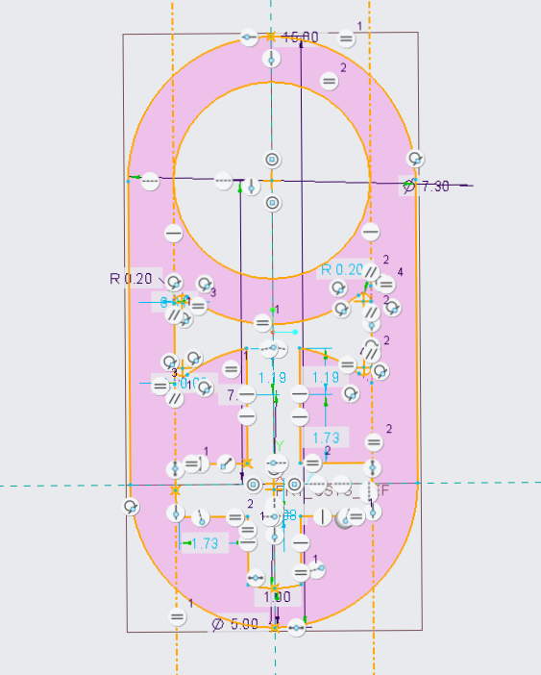
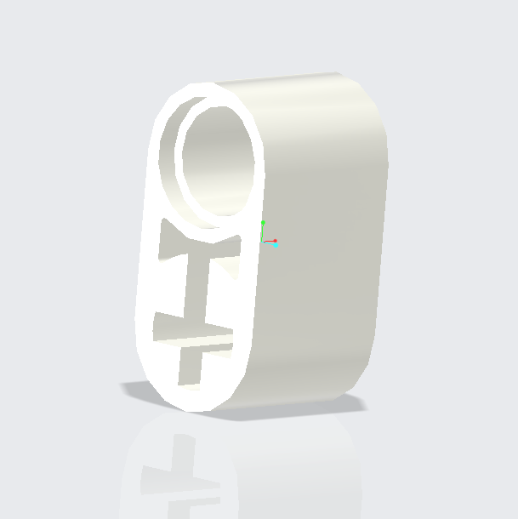
PART 6265135
Sketch : Line, Arc, Circle , Vertical Alignment, Tangent entities , Horizontal, Equal Radii
Extrude
Sketch and Extrude : Remove Material

Slide 10
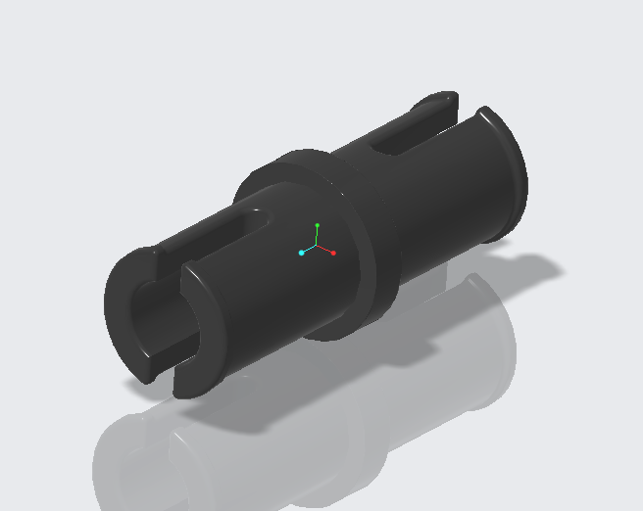
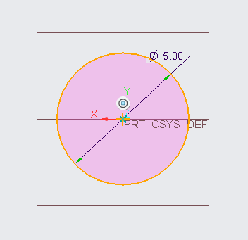
PART 6279875
Sketch : Circle , Line , Arc
Constraint : Tangent Entities , Vertical , Perpendicular Entities, Coincident Vertices
Revolve
Mirror
Round

Slide 11
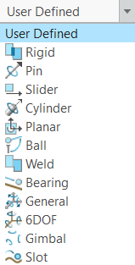
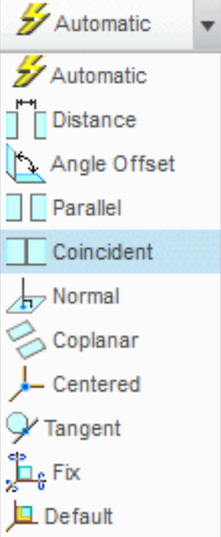
Assembly
Import Parts
Part Alignment and Assembly
Motion Simulation
Connectivity and Interference Checking

Slide 12
Assembly
Problems and CHALLENGES
Misalignment of Parts
Incorrect Constraints Application
Wrong Dimensions
Interference Between Parts

Slide 13

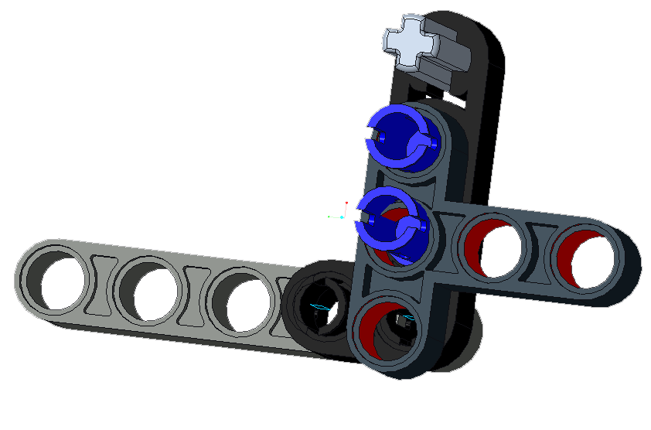
Problems and CHALLENGES
Misalignment of Parts
Incorrect Constraints Application
Wrong Dimensions
Interference Between Parts

Slide 14
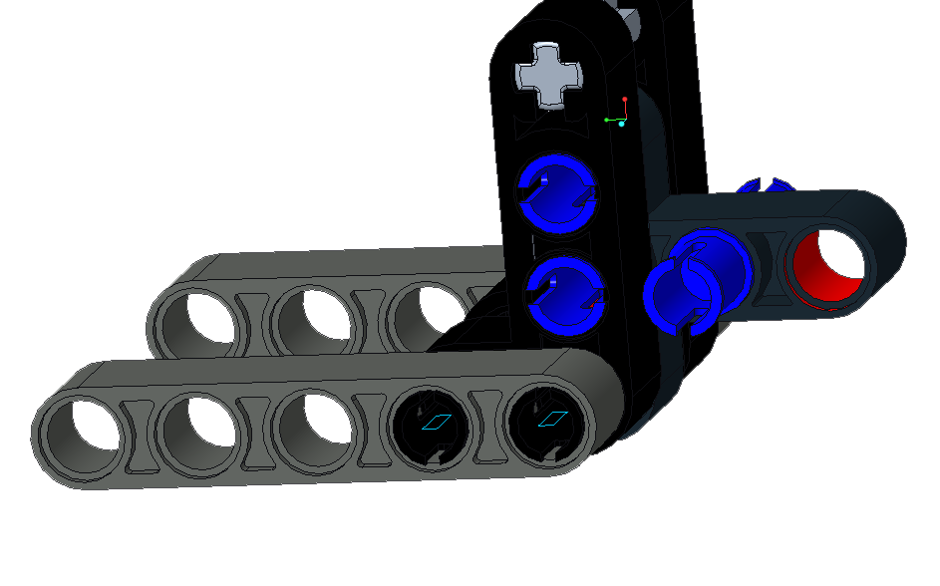

Problems and CHALLENGES
Misalignment of Parts
Incorrect Constraints Application
Wrong Dimensions
Interference Between Parts

Slide 15
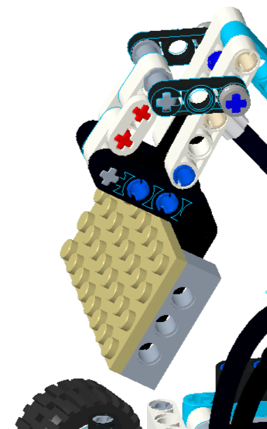
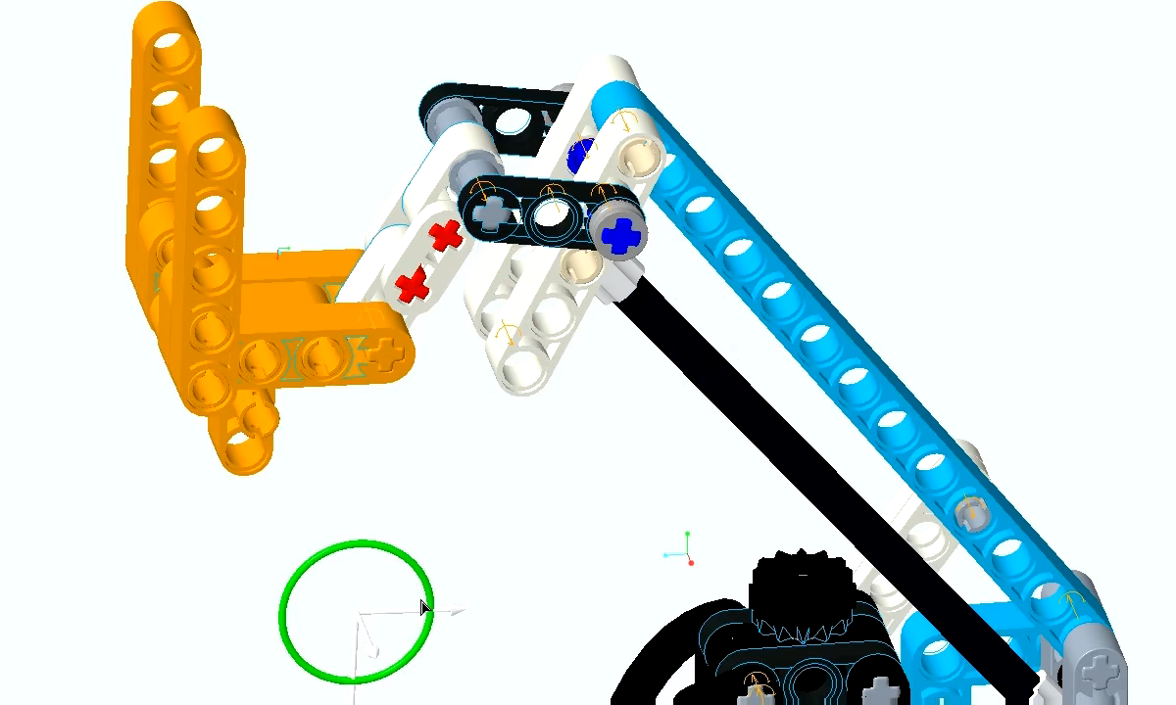
Problems and CHALLENGES
Misalignment of Parts
Incorrect Constraints Application
Wrong Dimensions
Interference Between Parts

Slide 16
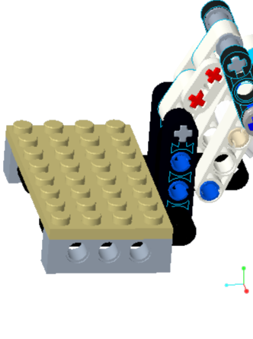
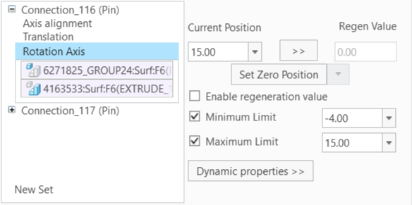
Problems and CHALLENGES
Misalignment of Parts
Incorrect Constraints Application
Wrong Dimensions
Interference Between Parts

Slide 17
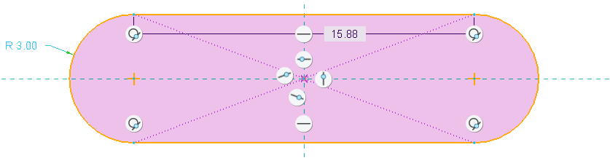
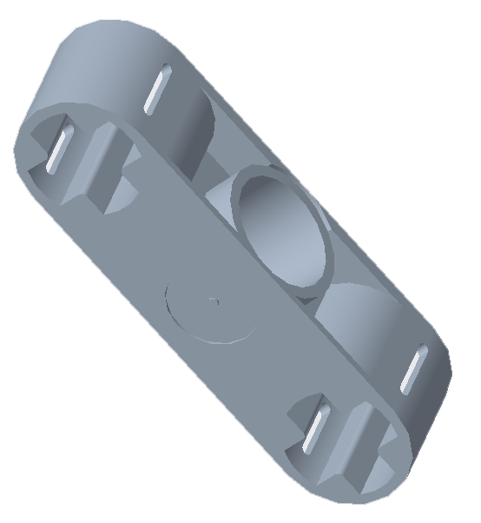
Problems and CHALLENGES
Misalignment of Parts
Incorrect Constraints Application
Wrong Dimensions
Interference Between Parts

Slide 18
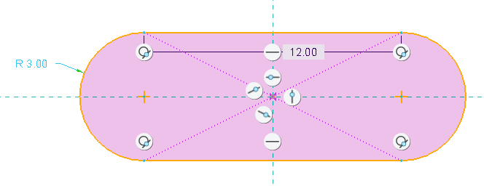
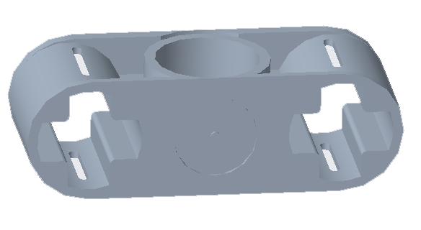
Problems and CHALLENGES
Misalignment of Parts
Incorrect Constraints Application
Wrong Dimensions
Interference Between Parts

Slide 19
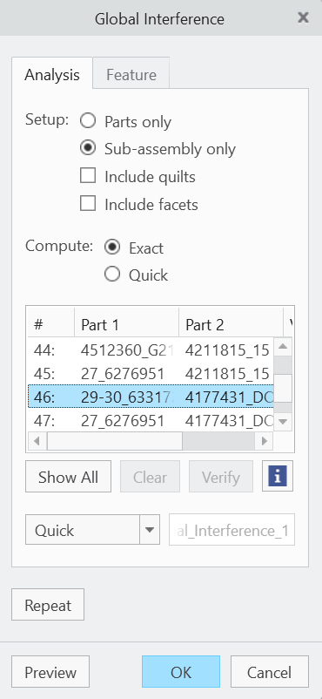
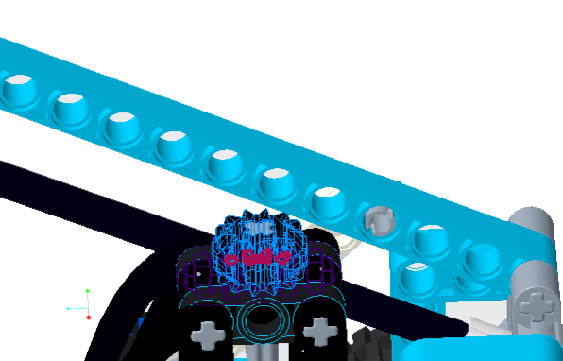
Problems and CHALLENGES
Misalignment of Parts
Incorrect Constraints Application
Wrong Dimensions
Interference Between Parts

Slide 20
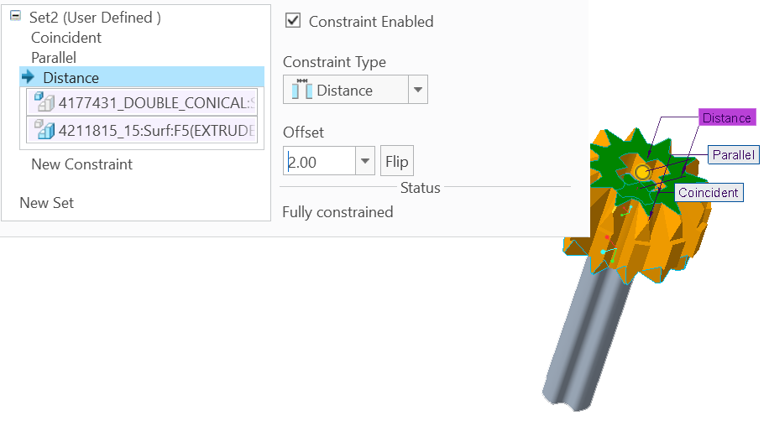
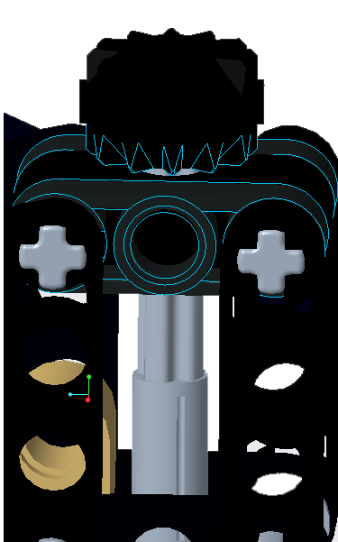
Problems and CHALLENGES
Misalignment of Parts
Incorrect Constraints Application
Wrong Dimensions
Interference Between Parts

Slide 21
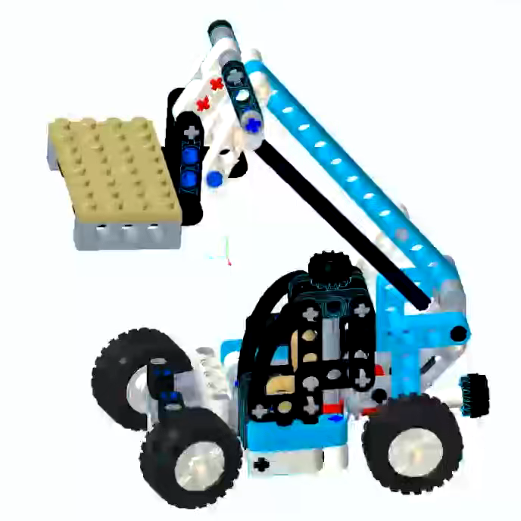
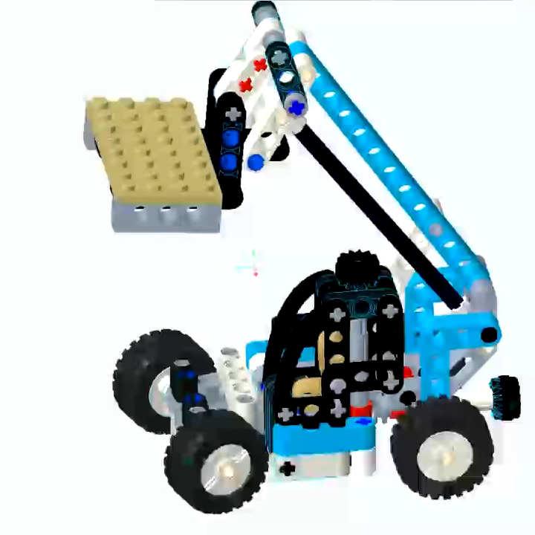
Motion

